Slide 1

HashCAT Demo Sean Meyer

Slide 2

Contents
Background
Uses
Features
Complimentary Tools
Demonstration

Slide 3

Background
Hashcat was created from the merging of two different projects “cudaHashcat” and “oclHashcat” into a comprehensive tool
cudaHashcat, released in April 2010 was designed for leveraging NVIDIA GPUs for password cracking
oclHashcat came along later with support for OpenCL-compatible GPUs from different manufacturers.
The combined utilization of these two projects birthed what we no know as Hashcat. Since then, it has grown with regular updates and improvements making it one of the most common password cracking tools available today.

Slide 4

Uses
Uses:
Password Cracking: Hashcat can crack passwords by trying different combinations until it finds the right one. It supports brute-force, dictionary, and rule-based attacks.
Security Audits: A common use is for security professionals to check an organizations current passwords for strength.
Forensics and Incident Response: In forensics, Hashcat can be used to recover passwords from damaged or compromised systems and encrypted files.
Research and Development: Hashcat can be used to evaluate the security of cryptographic algorithms and hash functions.

Slide 5

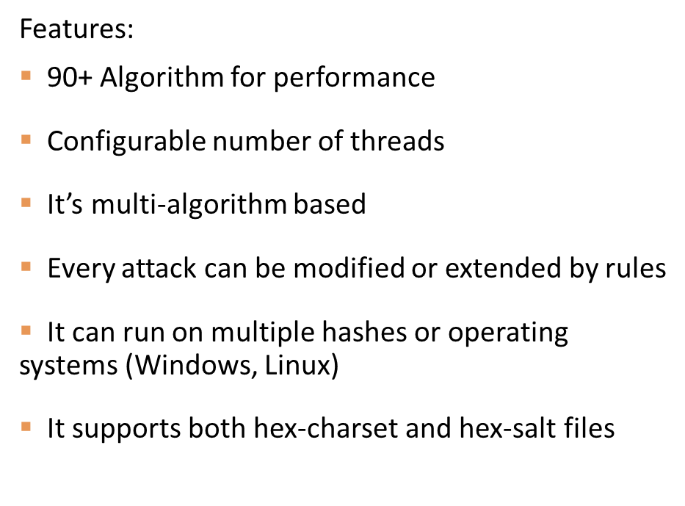
Features

Slide 6

Complimentary Tools
HashIdentifier: A simple but very handy tool for identifying the most likely hash-type of a discovered hash
Many times, a hashed password will be discovered, but it is unknown which algorithm it was hashed to. HashID makes this quick and easy
Hashcat-utils, is a small set of utilities that are useful when advanced password cracking is being attempted.

Slide 7
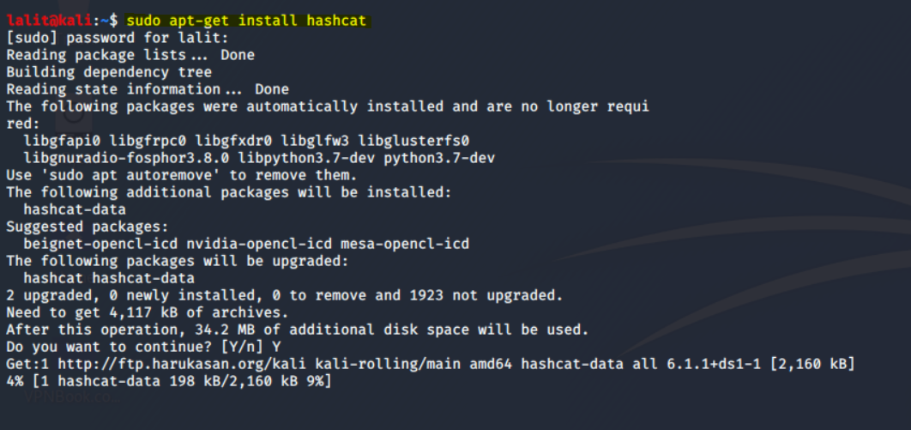
Demonstration
Installing Hashcat:
With some Linux distributions such as Kali Linux, Hashcat is most likely pre-installed.
If it is not, it can be by simply running the command “sudo apt-get install hashcat”
If you are using a GUI distribution, the icon for hashcat can be found under Password Cracking Tools
If you are running it from a terminal, more information can be found by running the hashcat –help command.

Slide 8
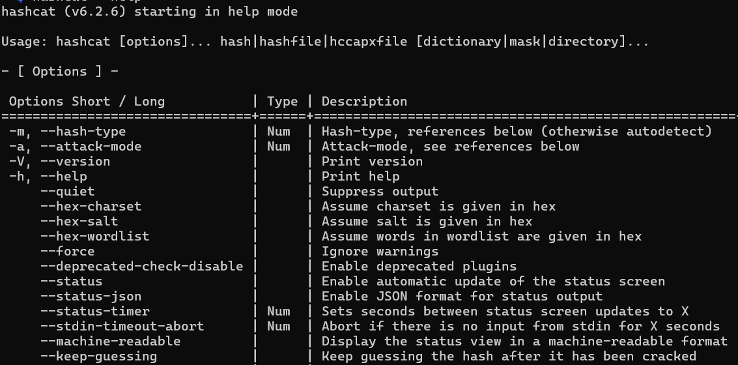
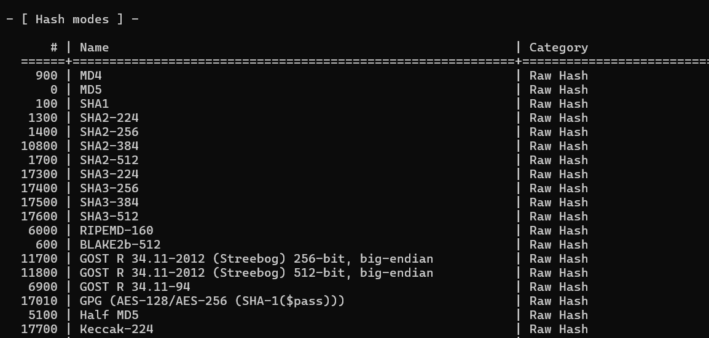
Hashcat --help
The hashcat help menu can be rather daunting, but the first section shows different flags that can be added to run specific functions or dictate the attack type desired.
Further down the menu screen, the Hash Modes section will allow you to tell Hashcat which type of hashing function you wish to run.
This is based on the type of hash you have or are believed to have. Usually, the results of HashIdentifier will dictate this.
Hashcat is a very thorough and advanced tool which allows penetration testers or security professionals to precisely run an attack to their exact specifications.

Slide 9

THANK YOU
Sean Meyer
smeyer2@students.columbiabasin.edu

